Slide 1

STRATEGIC MANAGEMENT IN
POLISH SPORT FEDERATIONS:
INTEGRATED VALUE CREATION MODEL AND SETTING
STRATEGIC GOALS
Miklós Stocker, PhD
Senior Assistant Professor Corvinus University of Budapest
Head of Sport Relations Department Ministry of Human Capacities
Warsaw - 28-29/05/2018

Slide 2


Schedule
1. Introduction
2. Part I: Integrated Value Creation Model
- Resources and competences
- Competitive advantage
3. Part II: Integrated Value Creation Model
- Created value to stakeholders
4. Part III: Setting goals
- Mission, vision, value statement and objectives
- Development projects to reach strategic goals
2

Slide 3

PART I: INTEGRATED VALUE CREATION MODEL
Resources and competences
Competitive advantage

Slide 4
Integrated Value
Creation Model
4

Slide 5
Integrated Value
Creation Model exp.
5

Slide 6
Applied resources
in the value creation
6

Slide 7
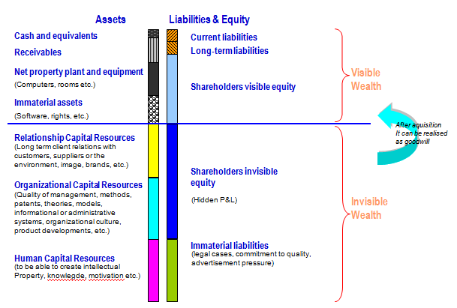
Tangible and intangible resources
7

Slide 8
Importance of
resources and competences
Organizations create value from tangible and intangible resources
- Tangible and intangible resources can be source of competitive advantage!
- If they are Valuable, Rare, Inimitable and exploited by the Organization (VRIO framework)
- However allocation and usage of resources cause costs!
- Competences are abilities which use resources
Quick service, efficient training schedule
8

Slide 9
Competitive advantage
An organization is said to have a competitive advantage when it is engaging in activities that increase its efficiency or effectiveness in ways that competing organizations are not.
Competitive advantage can only be understood in contrast to competitors!
Task: Who are your competitors?
- Which organizations offer similar value then your organization?
- Which organizations target similar clients then your organization?
- Which organizations compete for the same resources then your organization?
9

Slide 10
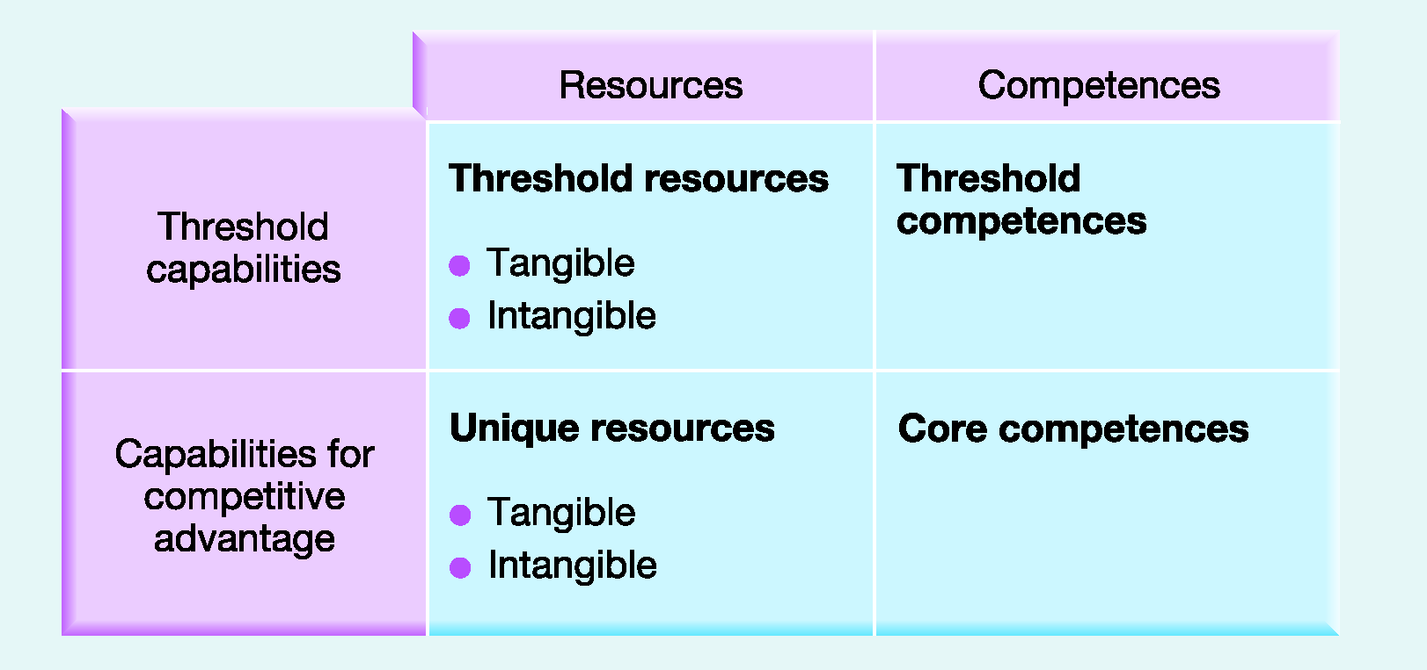
Strategic Capabilities
and Competitive Advantage
10

Slide 11

Group exercise

Slide 12
What are your most important resources and competencies?
- Form groups of 4-5 representatives, Choose one of your organizations
Task 1:
- Try to list as many resources and competences your organization has
- Categorize them into the Strategic Capabilities and Competitive Advantage matrix
Task 2:
- Try to list as many resources and competences your organization is longing to have
- Categorize them into the Strategic Capabilities and Competitive Advantage matrix
12

Slide 13
PART II: INTEGRATED VALUE CREATION MODEL
Created value to stakeholders

Slide 14
Created value
14

Slide 15
Value
Value is defined as the degree of usefulness or desirability of something, especially in comparison with other things
Tangible value:
physical products created or consumed during a need is satisfied which generally can be measured by money owing to its objective nature
Intangible (immaterial) value
which is hard to be measured by money, as it is created in the individual's mind who participates in the value creation process
15

Slide 16
Value categories
and examples
 | Value
Categories | Materialized | Immaterialized
 |  | Included in Contract | Not Included in Contract
 | Tangible Value |  | Intangible Value
Example | Product | Knowledge Increase | Reputation, good relationship
Example from Sports | Merchandise Products | Cheering Experience | Sense of Victory, Glory, Community
16

Slide 17
Created value to stakeholders
- You have identified your relevant stakeholders yesterday
- Task:
- Who are those relevant stakeholders? What kind of value does your organization create to them?
- What is the contribution from the recipient for the value he has got?
17

Slide 18
PART III: SETTING GOALS
- Mission
- Vision
- Value Statement
- Objectives

Slide 19
Mission statements
A mission statement aims to provide employees and stakeholders with clarity about the overriding purpose of the organisation
A mission statement should answer the questions:
What business are we in?’
‘How do we make a difference?’
‘Why do we do this?’
19

Slide 20
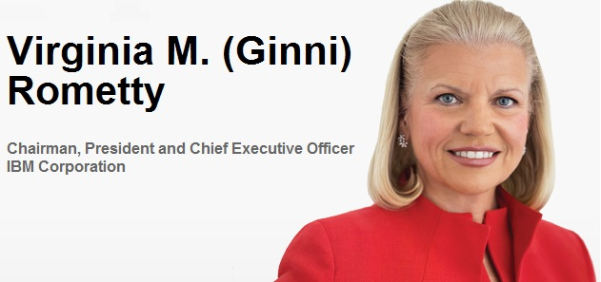

Mission statements
Mission statement: At IBM, we strive to lead in the invention, development and manufacture of the industry's most advanced information technologies, including computer systems, software, storage systems and microelectronics.
We translate these advanced technologies into value for our customers through our professional solutions, services and consulting businesses worldwide
20

Slide 21
Vision statements
A vision statement is concerned with the desired future state of the organisation; an aspiration that will enthuse, gain commitment and stretch performance.
A vision statement should answer the question :
‘What do we want to achieve?’
21

Slide 22
Vision
Vision in Hungarian Sport Strategy:
  - Every children should do sport
  - Quality sport infrastructure should be available
  - Host as many international sport events as possible
GE Transportation:
  - Being a global technology leader & supplier to the railroad, mining, marine, stationary power & drilling industries
Vision of Hungarian Table Tennis Association:
  - The common vision of the Hungarian table tennis society is the healthy Hungarian Nation, from which hundreds of thousands choose table tennis as regular exercise for health prevention
22

Slide 23
Statement of corporate values
A statement of corporate values should communicate the underlying and enduring core ‘principles’ that guide an organisation’s strategy and define the way that the organisation should operate.
Such core values should remain intact whatever the circumstances and constraints faced by the organisation.
Also known as the corporate philosophy
23

Slide 24
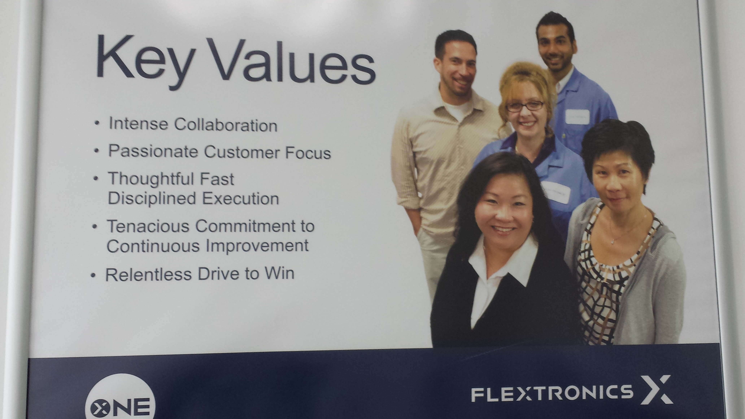
Value statement examples
KPMG:
- People, Knowledge, Client
HTTA
- Children playing table tennis
- Humbleness, diligence hard work
- Coaching and knowledge sharing
- Health
24

Slide 25
Objectives
Objectives are statements of specific outcomes
that are to be achieved.
Objectives are frequently expressed in:
- financial terms (e.g. desired profit levels)
- market terms (e.g. desired market share)
- increasingly social terms (e.g. corporate
social responsibility targets)
25

Slide 26
Strategic objectives – examples
Strategic objectives at IBM:
  - To grow revenues at least 5% each year
  - To increase earnings per share at least 10%
Strategic objectives at HTTA:
  - Increase number of registered table tennis players to 7500 in 2020
  - Increase number of table tennis coaches to 300 in 2020
  - Increase the number of sponsorship relationships and their cash in-flow
26

Slide 27
Strategic objectives can only be reached with developmental projects
- Current state – base plan
- Developmental projects
- Desired state
Base plan
27

Slide 28
Strategic objectives can only be reached with developmental projects
- Create potential projects to reach strategic objectives.
Challenge projects with current resources, capabilities and processes.
Select those projects (under budget constraints) which deliver the most effect for reaching the strategic objectives.
- Annual feedback: measure the improvement related to the strategic objectives!
28

Slide 29
Thank you for your attention and participation!
Questions and comments are welcome!
Miklós Stocker, PhD
Senior Assistant Professor Corvinus University of Budapest
Head of Sport Relations Department Ministry of Human Capacities
29

